Slide 1
Blue Economy

Slide 2
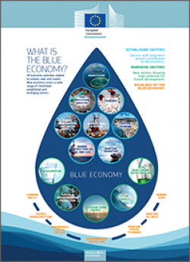
What is Blue Economy?
Blue Economy is the sustainable use of ocean recources for economic growth. Blue Economy is a campaign for cleaning the ocean and saving the animals, to make our world better for living and make it more economical.

Slide 3
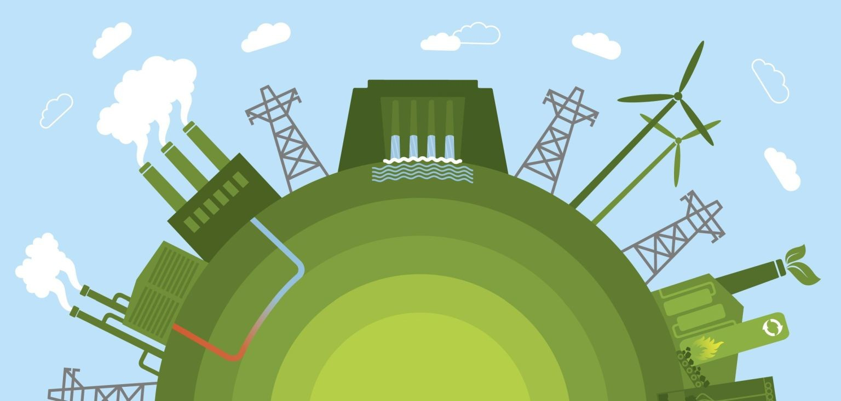
Energy Economics
Energy economics represents producing energy using wind mills and water turbines, so in that way we don’t pollute our earth and use the natural recources to produce energy.

Slide 4

Our site
In our site you will find information about:
Energy Economics
How to produce Energy, using our nature and the natural recources
Why it is better to use less energy

Slide 5

Purpose of our project
The purpose of our project is to inform people about the blue economy and energy producing, using the natural recources, and how to reduce pollution.

Slide 6
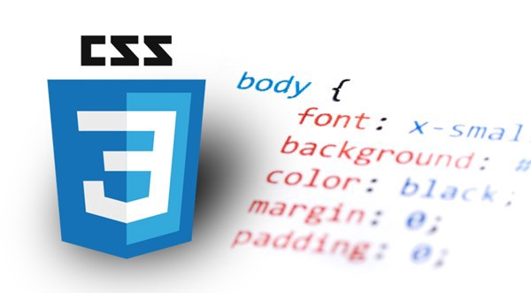

Technologies we used in our site
For the development of our site we used:
HTML 5 – for the main pages and the information in the site
CSS 3 – for the design of our site

Slide 7

Our team
Manager : Viktor Georgiev Kavaldzhiev,
Email: vgkavaldzhiev18@codingburgas.bg, PGKPI, 9 ”v”
Designer : Nevena Stoyanova Pavlova,
Email: NSPavlova18@codingburgas.bg, PGKPI, 9”b”
Developer : Kaloyan Dimitrov Dimov,
Email: KDDimov18@codingburgas.bg, PGKPI, 9”b”

Slide 8

Thanks for the attention!

